Slide 1
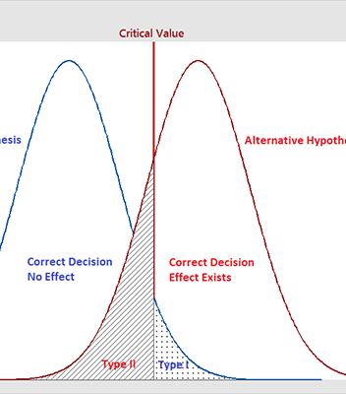
Hypothesis Testing

Slide 2
Y=f(X)

Slide 3
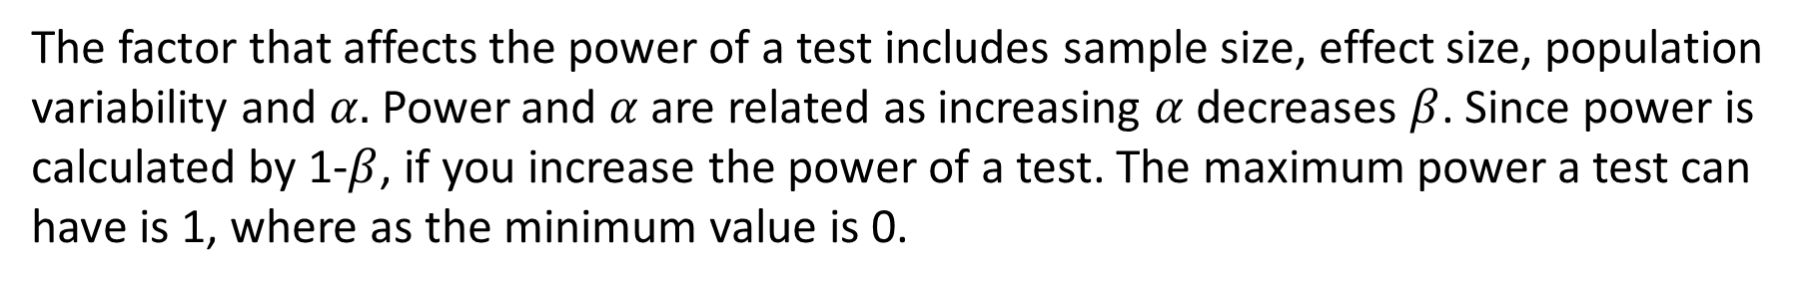
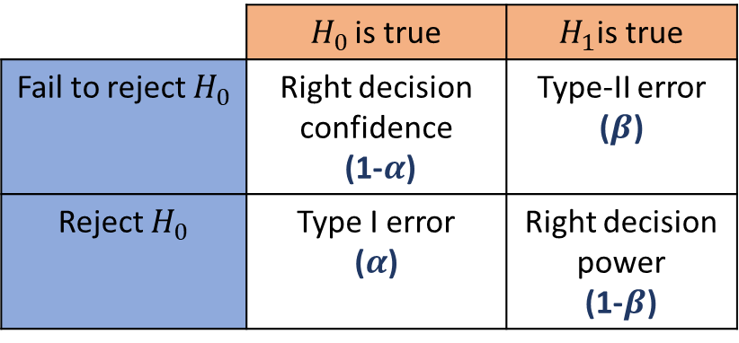
Hypothesis Testing
Start with Hypothesis about population parameter
Parameter could be mean, proportion or something else
Collect Sample Information
Collect information from a randomly chosen sample & calculate the appropriate sample statistic
Reject/Do Not Reject Hypothesis
Is the sample information strongly inconsistent with the null hypothesis? If yes, then reject the hypothesis.
 | $H_{0 }$is true | $H_{1}$is true
Fail to reject $H_{0}$ | Right decision confidence (1-$α$) | Type-II error ($β$)
Reject $H_{0}$ | Type I error ($α$) | Right decision power (1-$β$)
The factor that affects the power of a test includes sample size, effect size, population variability and $α.$Power and $α$ are related as increasing $α$ decreases $β$. Since power is calculated by 1-$β$, if you increase the power of a test. The maximum power a test can have is 1, where as the minimum value is 0.

Slide 4
Our quality will not improve after the consulting project
Our potential customers don’t spend more than 60 minutes on the web everyday
We will need 400 more person hours to finish this project
The retail market will grow by 50% in the next 5 years
Less than 5% clients will default their loans
We will acquire 80000 new customers if I open a store in this area
Various Scenarios

Slide 5
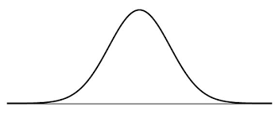
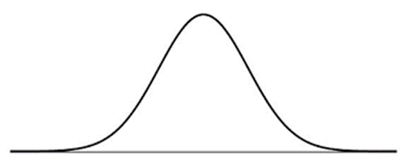
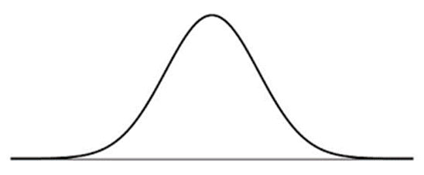
One tail and Two tail
Greater than a set value, one tailed to the right
Or less than a set value, one tailed to the left

Slide 6
Hypothesis Testing
Y | X | Test
Continuous | Discrete in 2 categories | 2-Sample test
Continuous | Discrete in more than 2 categories | ANOVA- One Way
Discrete | Discrete in 2 categories | 2-proportion test
Discrete | Discrete in 2 categories | Chi- square test

Slide 7
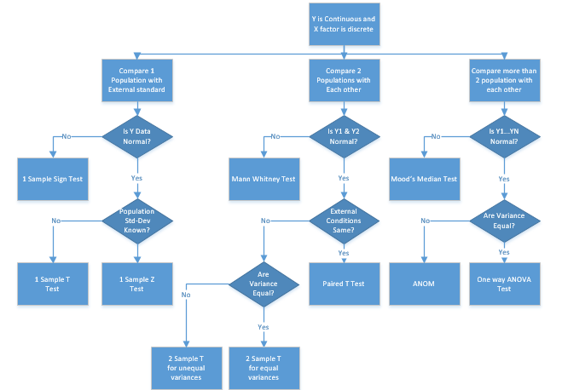
Continuous Y and Discrete X

Slide 8
Paired t test
The paired sample t-test, sometimes called the dependent sample t-test, is a statistical procedure used to determine whether the mean difference between two sets of observations is zero.
In a paired sample t-test, each subject or entity is measured twice, resulting in pairs of observations.

Slide 9
Paired t test
Normality Test
Paired t test
Stat> Basic Statistics> Graphical Summary
Stat> Basic Statistics> Paired t test

Slide 10
Paired t-test- Resting Heart Rate
A physiologist wants to determine whether a particular running program has an effect on resting heart rate.
The heart rates of 15 randomly selected people were measured. The people were then put on the running program and measured again one year later.
Thus, the before and after measurements for each person are a pair of observations.
Determine whether the heart rates differ before and after the running program.

Slide 11
2-Sample Test
The two-sample t-test is one of the most commonly used hypothesis tests in Six Sigma work.
It is applied to compare whether the average difference between two groups is significant or due to random chance.

Slide 12
2- Sample Test
Normality Test
Variance Test
2 Sample Test
Stat> Basic Statistics> Graphical Summary
Stat> Basic Statistics> 2 Variance
Stat> Basic Statistics> 2- Sample t Test

Slide 13
2- Sample t-test- Marketing Strategy
A financial analyst at a financial institute wants to evaluate a recent credit card promotion.
After this promotion, cardholders were randomly selected.
Half received an ad promoting a full waiver of interest rate on purchases made over the next three months, and half received a standard Christmas ad.
Did the ad promoting full interest rate waiver increase purchase?

Slide 14
Mann-Whitney Test
Mann-Whitney Test is a nonparametric test of the null hypothesis that it is equally likely that a randomly selected value from one sample will be less than or greater than a randomly selected value from a second sample.
This test can be used to determine whether two independent samples were selected from populations having the same distribution.

Slide 15
Mann- Whitney Test
Normality Test
Stat> Basic Statistics> Graphical Summary
Median Test
Stat> Non Parametric>Mann Whitney

Slide 16
Mann- Whitney Test- Vehicle Fuel Additive
A state highway department uses two brands of paint for painting stripes on roads.
A highway official wants to know whether the durability of the two brands of paint are different.
For each paint, the official records the number of months the paint persists on the highway.
Determine whether the median number of months that the paint persists differs between the two brands.

Slide 17
One-Way ANOVA
Normality Test
Stat> Basic Statistics> Graphical Summary
Variance Test
Stat> ANOVA> Test for Equal Variance
ANOVA
Stat> ANOVA> One-way ANOVA

Slide 18
One-way ANOVA- Contract Renewal
A marketing organization outsources their back-office operations to three different suppliers. The contracts are up for renewal & the CMO wants to determine whether they should renew contracts with all supplies or any specific supplier.
CMO want to renew the contract of the supplier with the last transaction time and he will renew all contracts if the performance of all suppliers is similar.

Slide 19
Analysis of Variance (ANOVA)
ANOVA can be used to test equality of means when there are more than 2 populations.
ANOVA can be used with one or two factors.
If only one factor is varying, then we would use a one-way ANOVA.
E.g.: We are interested in comparing the mean performance of several departments within a company. Here, the only factor is the name of department.
If there are two factors, we would use a two way ANOVA.
E.g.: One factor is department & the second factor is shift (day v/s night).

Slide 20
More weight reduction programs
Suppose the nutrition expert would like to do a comparative evaluation of three diet programs (Atkins, South Beach, GM).
She randomly assigns equal number of participants to each of the programs from a common pool of volunteers
Suppose the average weight losses in each of the groups (arms) of the experiments are 4.5 kg, 7 kg, 5.3 kg.
What can she conclude?

Slide 21
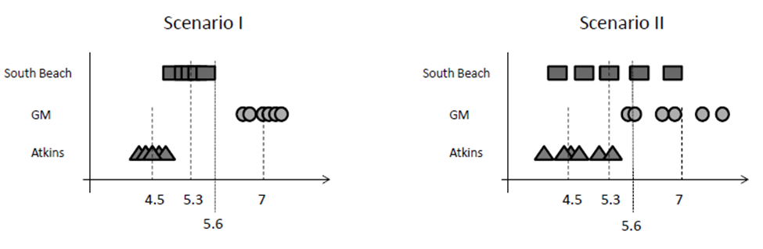
Two kinds of variation matter
Not every individual in each program will respond identically to the diet program
Easier to identify variations across programs if variations within program are smaller
Hence, the method is called Analysis of Variance (ANOVA).

Slide 22
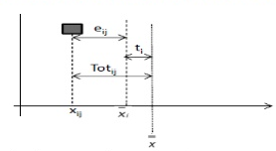
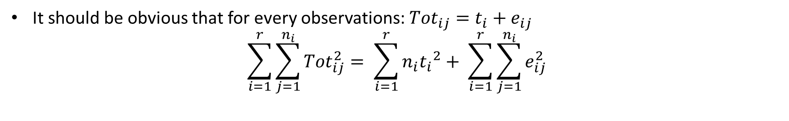
Formalizing the intuition
It should be obvious that for every observations: ${Tot}_{ij}=t_{i}+e_{ij}$
$$\sum_{i=1}^{r}{\sum_{j=1}^{n_{i}}{{Tot}_{ij}^{2}}= \sum_{i=1}^{r}{{n_{i}t_{i}}^{2}+ \sum_{i=1}^{r}{\sum_{j=1}^{n_{i}}{e_{ij}^{2}}}}}$$
Sum of Square Total (SST)
Sum of Square Treatment (SSTR)
Sum of Squares error (SSE)

Slide 23
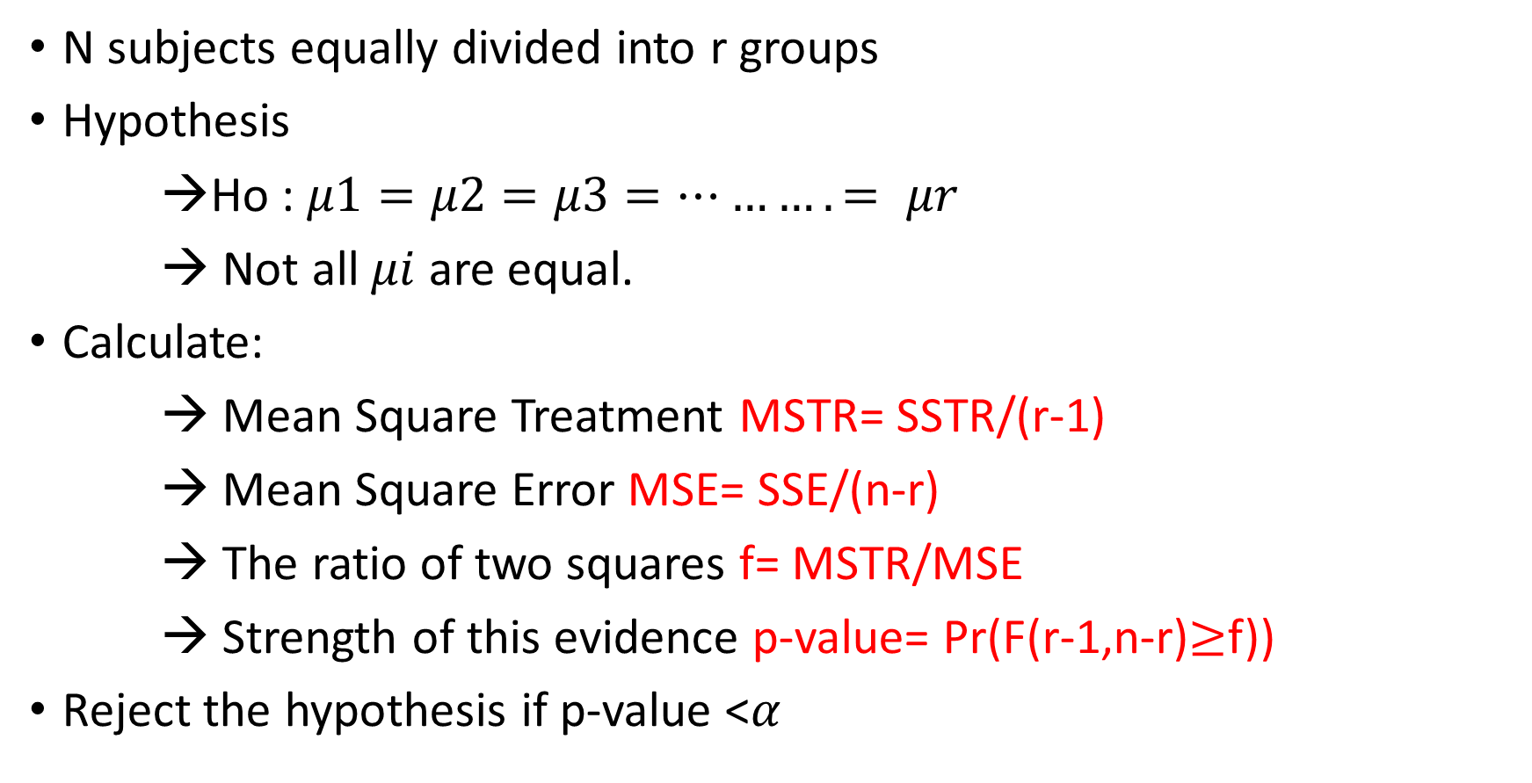
Statistically test for equality means
N subjects equally divided into r groups
Hypothesis
→Ho : $μ1=μ2=μ3=………. = μr$
→ Not all $μi$ are equal.
Calculate:
→ Mean Square Treatment MSTR= SSTR/(r-1)
→ Mean Square Error MSE= SSE/(n-r)
→ The ratio of two squares f= MSTR/MSE
→ Strength of this evidence p-value= Pr(F(r-1,n-r)$≥$f))
Reject the hypothesis if p-value <$α$

Slide 24
ANOM- Analysis of Mean
Use Analysis of Means to determine whether the mean of each group differs from the overall mean.
Analysis of means is a graphical alternative to ANOVA.

Slide 25
ANOM- Analysis of Mean
ANOM
Stat> ANOVA> Analysis of Mean
Normality Test
Stat> Basic Statistics> Graphical Summary
Variance Test
Stat> ANOVA> Test for Equal Variance

Slide 26
ANOM- Road Conditions
A safety analyst wants to compare how well experienced and inexperienced drivers drive on three types of roads: paved, gravel, and dirt.
To measure driving performance, the analyst records the time in seconds that each driver uses to make steering corrections on each type of road.
Determine whether the means for experience level and type of road are different from the overall mean.

Slide 27
Mood’s Median & Kruskal-Wallis
The Mood’s median test is a nonparametric test that is used to test the equality of medians from two or more populations.
The Kruskal–Wallis test is a non-parametric method for testing whether samples originate from the same distribution.
Mood's median test is more robust to outliers than the Kruskal-Wallis test, but is less powerful in the absence of outliers.
In case of extreme outliers, Mood’s Median test should be preferred.

Slide 28
Mood’s Median & Kruskal Wallis
Mood’s Median
Stat>Non parametric>Mood’s median
Kruskal Wallis
Stat>Non parametric> Kruskal Wallis

Slide 29
Mood’s Median-Fish Weights
An environmental scientist wants to determine whether temperature changes in the ocean near a nuclear power plant affect the growth of fish.
The scientist randomly divides 25 newly hatched fish into four groups and places each group into a separate, simulated ocean environment.
The simulated environments are identical except for temperature. Six months later, the scientist measures the weights of the fish.
Determine whether the median weight of the fish differs among the four groups, the scientist uses Mood's median test.

Slide 30
Kruskal-Wallis- Hospital Beds
A health administrator wants to compare the number of unoccupied beds for three hospitals.
The administrator randomly selects 11 days from the records of each hospital and enters the number of unoccupied beds for each day.
To determine whether the median number of unoccupied beds differs, the administrator uses the Kruskal-Wallis test.

Slide 31
1-Sample Z test
A one-sample z-test is used to test whether a population parameter is significantly different from some hypothesized value.

Slide 32
1- Sample Z test
Normality Test
Stat> Basic Statistics> Graphical Summary
1-Sample Z test
Stat> Basic Statistics> 1 Sample Z
Population Standard Deviation Known

Slide 33
1- Sample Z test- Fabric Data
The length of 25 samples of a fabric are taken at random.
Mean and standard deviation from the historic 2 years study are 150 and 4 respectively.
Test if the current mean is greater than the historic mean. Assume α to be 0.05

Slide 34
1-Sample t test
The one sample t-test is a statistical procedure used to determine whether a sample of observations could have been generated by a process with a specific mean.

Slide 35
1- Sample t test
Normality Test
Stat> Basic Statistics> Graphical Summary
1-Sample t test
Stat> Basic Statistics> 1 Sample t
Population Standard Deviation Not Known

Slide 36
1 Sample t test- Expenditure Cost
A statistician wants to determine whether the monthly expenditure cost for families has changed from the previous year, when the mean cost per month was $300.
The statistician randomly samples 28 families and records their expenditure costs for the current year.

Slide 37
1-Sample Sign test
The Sign test is a non-parametric test that is used to test whether the two groups are equally sized.
The sign test is used when dependent samples are ordered in pairs, where the bivariate random variables are mutually independent

Slide 38
1- Sample Sign test
Normality Test
Stat> Basic Statistics> Graphical Summary
1-Sample sign test
Stat> Non Parametric > 1 Sample Sign

Slide 39
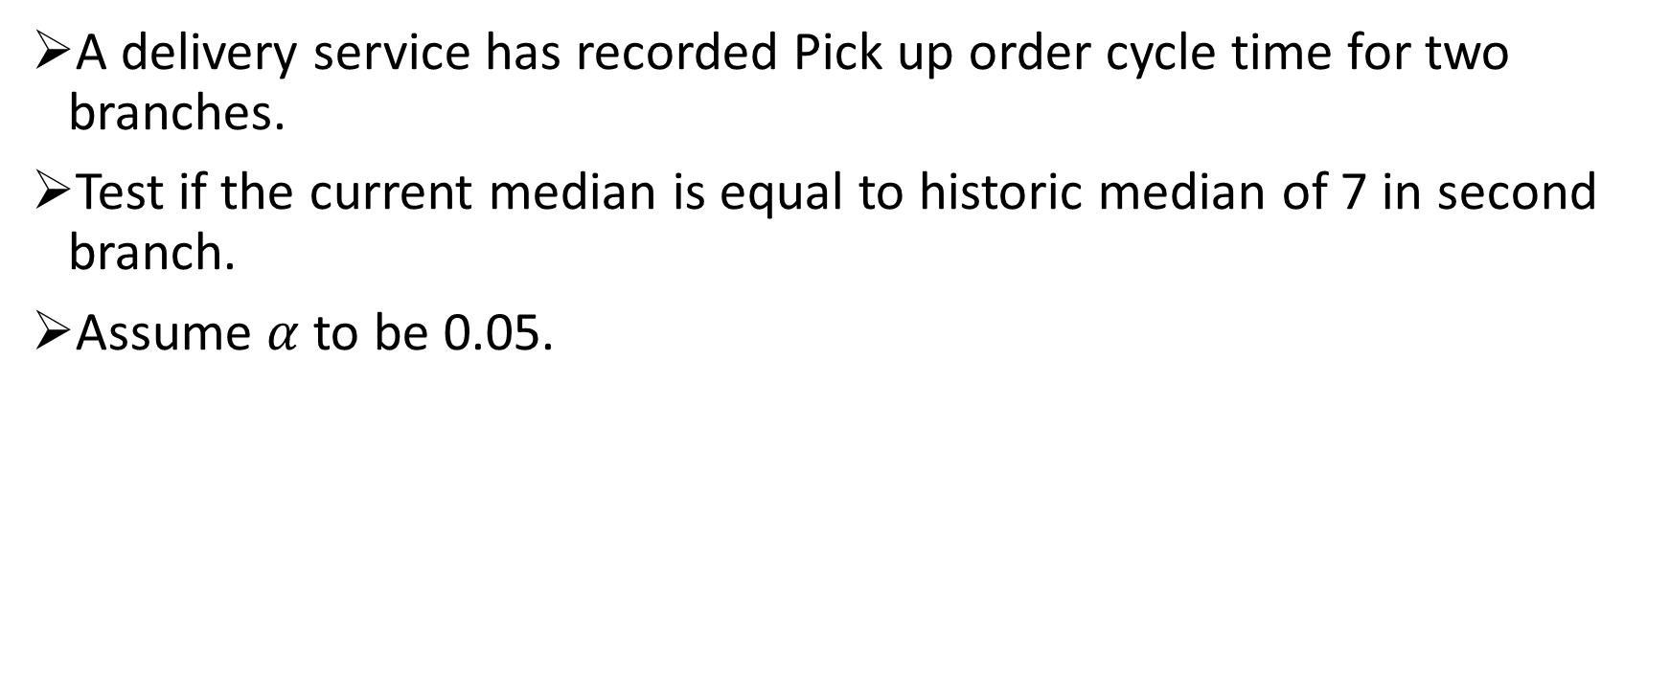
1- Sample Sign test- Pick up order cycle time
A delivery service has recorded Pick up order cycle time for two branches.
Test if the current median is equal to historic median of 7 in second branch.
Assume $α$to be 0.05.

Slide 40
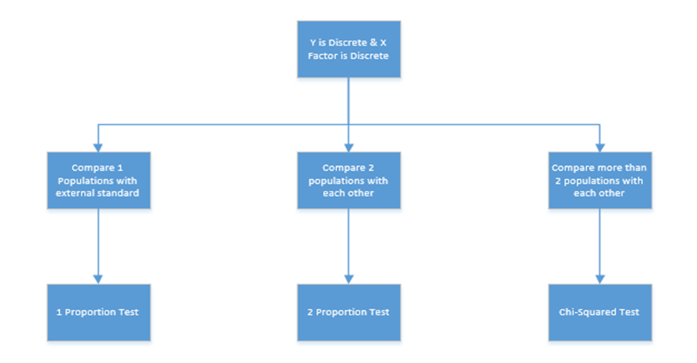

Slide 41
Proportion Tests
The One-Sample Proportion Test is used to assess whether a population proportion (P1) is significantly different from a hypothesized value (P0).
The Two Sample Proportion Test is a hypothesis test to determine whether the difference between two proportions is significant.

Slide 42
1-Proportion Test
Stat
Basic Statistics
1-Proportion Test

Slide 43

One Proportion Test- Delivery Time
An Independent vendor has guaranteed 48-hour delivery for delivering his products.
The Vendor wants to find out whether he can keep his promise or not.
Analyze using $α$=0.05.

Slide 44
2- Proportion Test
$$H_{o}$$
𝐻_𝑜
Proportion A= Proportion B
Check p-value
$$H_{1}$$
𝐻_1
Proportion A $≠$ Proportion B
Proportion A ≠ Proportion B
If p-value< $α$, reject $H_{0}$
If p-value< 𝛼, reject 𝐻_0

Slide 45
2- Proportion Test- Johnnie Talkers
Johnnie Talkers soft drinks division sales manager has been planning to launch a new sales incentive program for their sales executives.
The sales executives felt that adults (>40 years) won’t buy, children will & hence requested sales manager not to launch the program.
Analyze the data & determine whether there is evidence at 5% significance level to support the hypothesis

Slide 46
Chi-Square Test
The Chi Square statistic is commonly used for testing relationships between categorical variables.
The null hypothesis of the Chi-Square test is that no relationship exists on the categorical variables in the population; they are independent.

Slide 47
Chi-Square Test
$$H_{0}$$
𝐻_0
All proportions are equal
Check p-value
$$H_{1}$$
𝐻_1
Not all proportions are equal
If p-value< $α$, we reject $H_{0}$
If p-value< 𝛼, we reject 𝐻_0

Slide 48
Chi- Square Test- Bahaman Research
BahamanTech Research Company uses 4 regional centers in South Asia (India, China, Sri Lanka and Bangladesh) to input data of questionnaire responses.
They audit a certain % of the questionnaire responses versus data entry.
Any error in data entry renders it defective. The chief data scientist wants to check whether the defective % varies by country.
Analyze the data at 5% significance level and help the manager draw appropriate inferences. [‘1’ means not defective & ‘0’ means defective]

